Slide 1


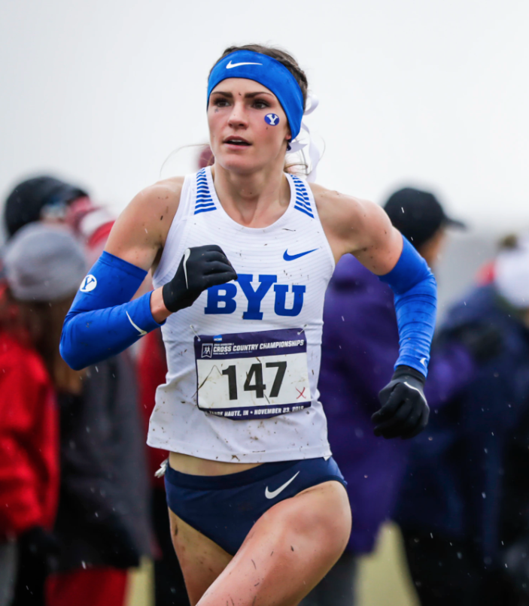
The myth of what it takes to be a successful female distance runner
THIN TO WIN?
Diljeet Taylor

Slide 2
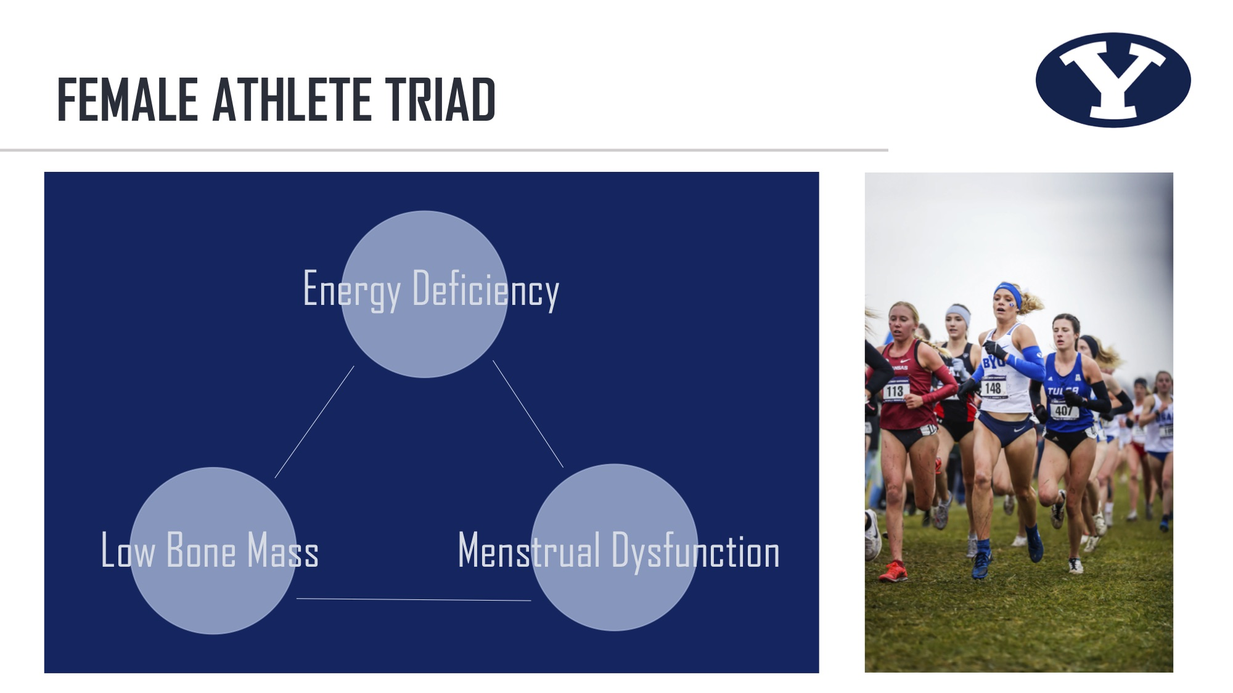
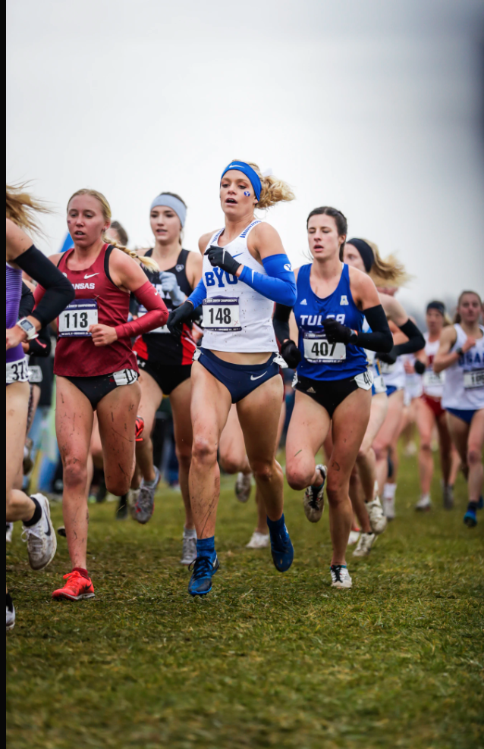
FEMALE ATHLETE TRIAD
Energy Deficiency
Low Bone Mass
Menstrual Dysfunction

Slide 3
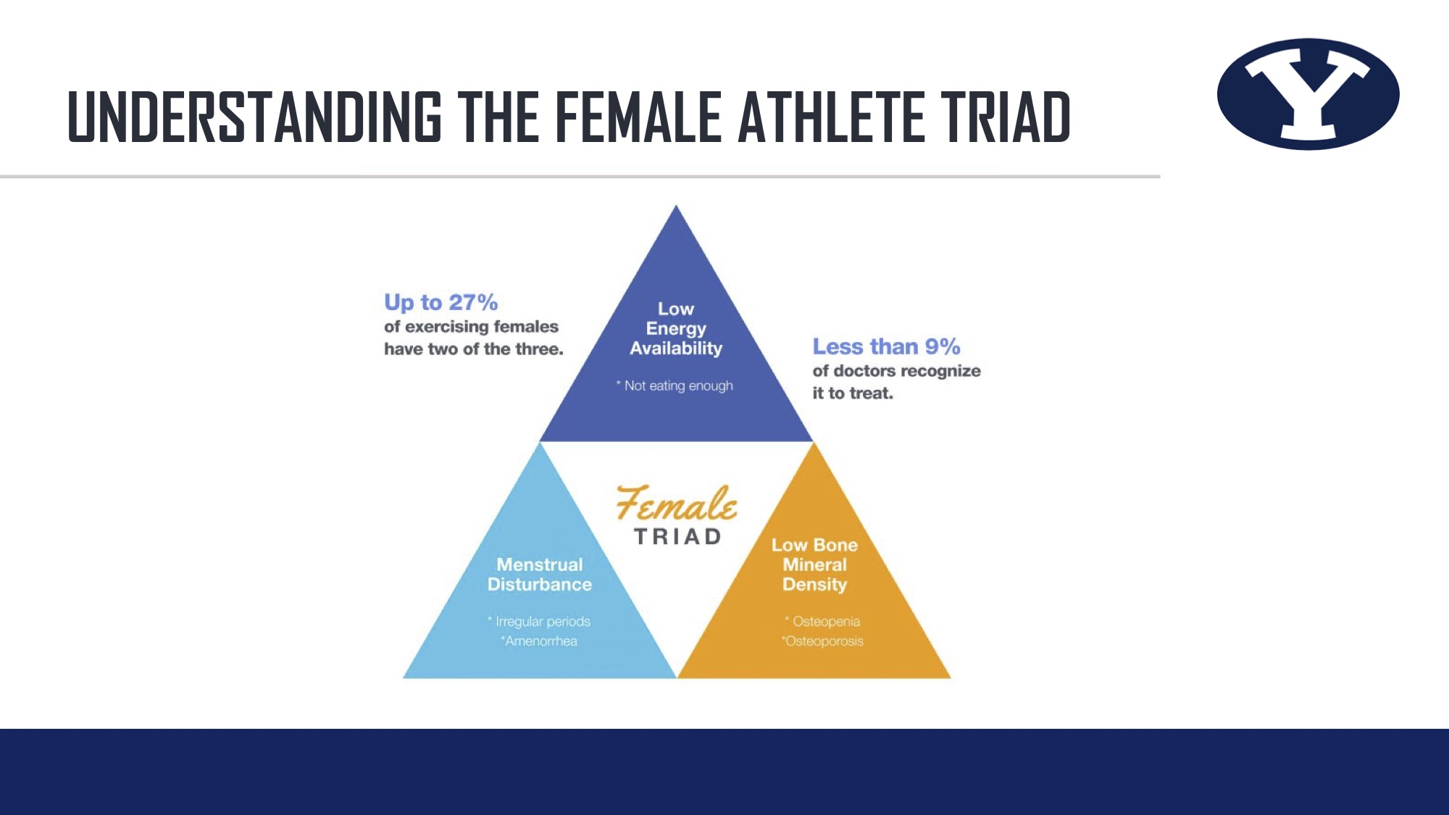
UNDERSTANDING THE FEMALE ATHLETE TRIAD

Slide 4
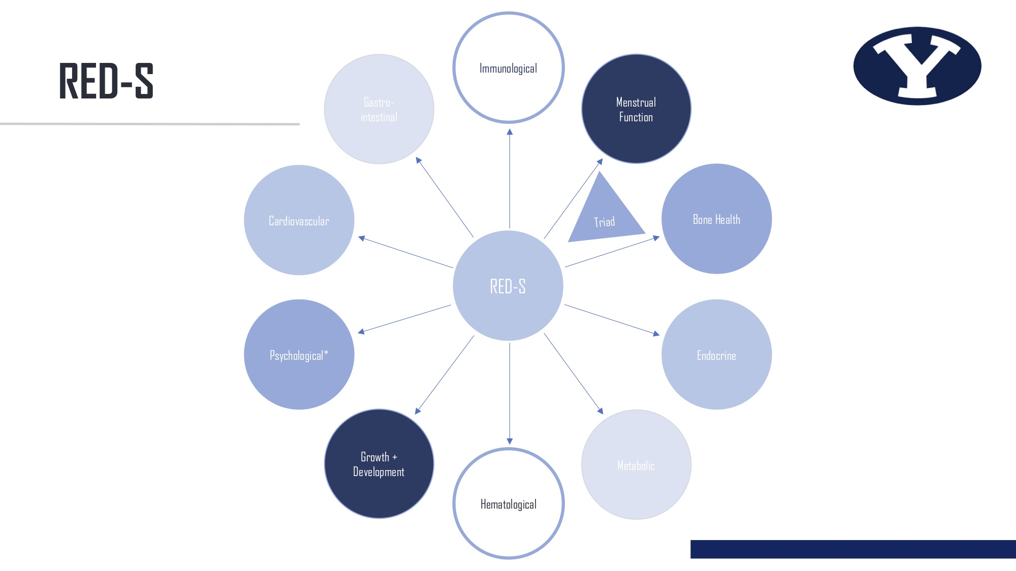
RED-S
Immunological
Gastro-intestinal
Menstrual Function
Cardiovascular
Triad
Bone Health
RED-S
Psychological*
Endocrine
Growth + Development
Metabolic
Hematological

Slide 5
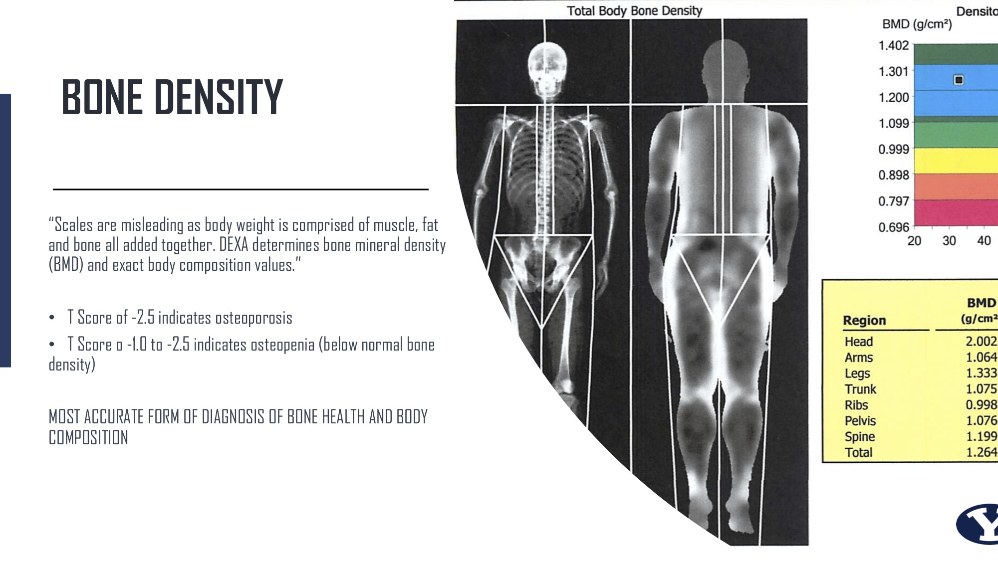
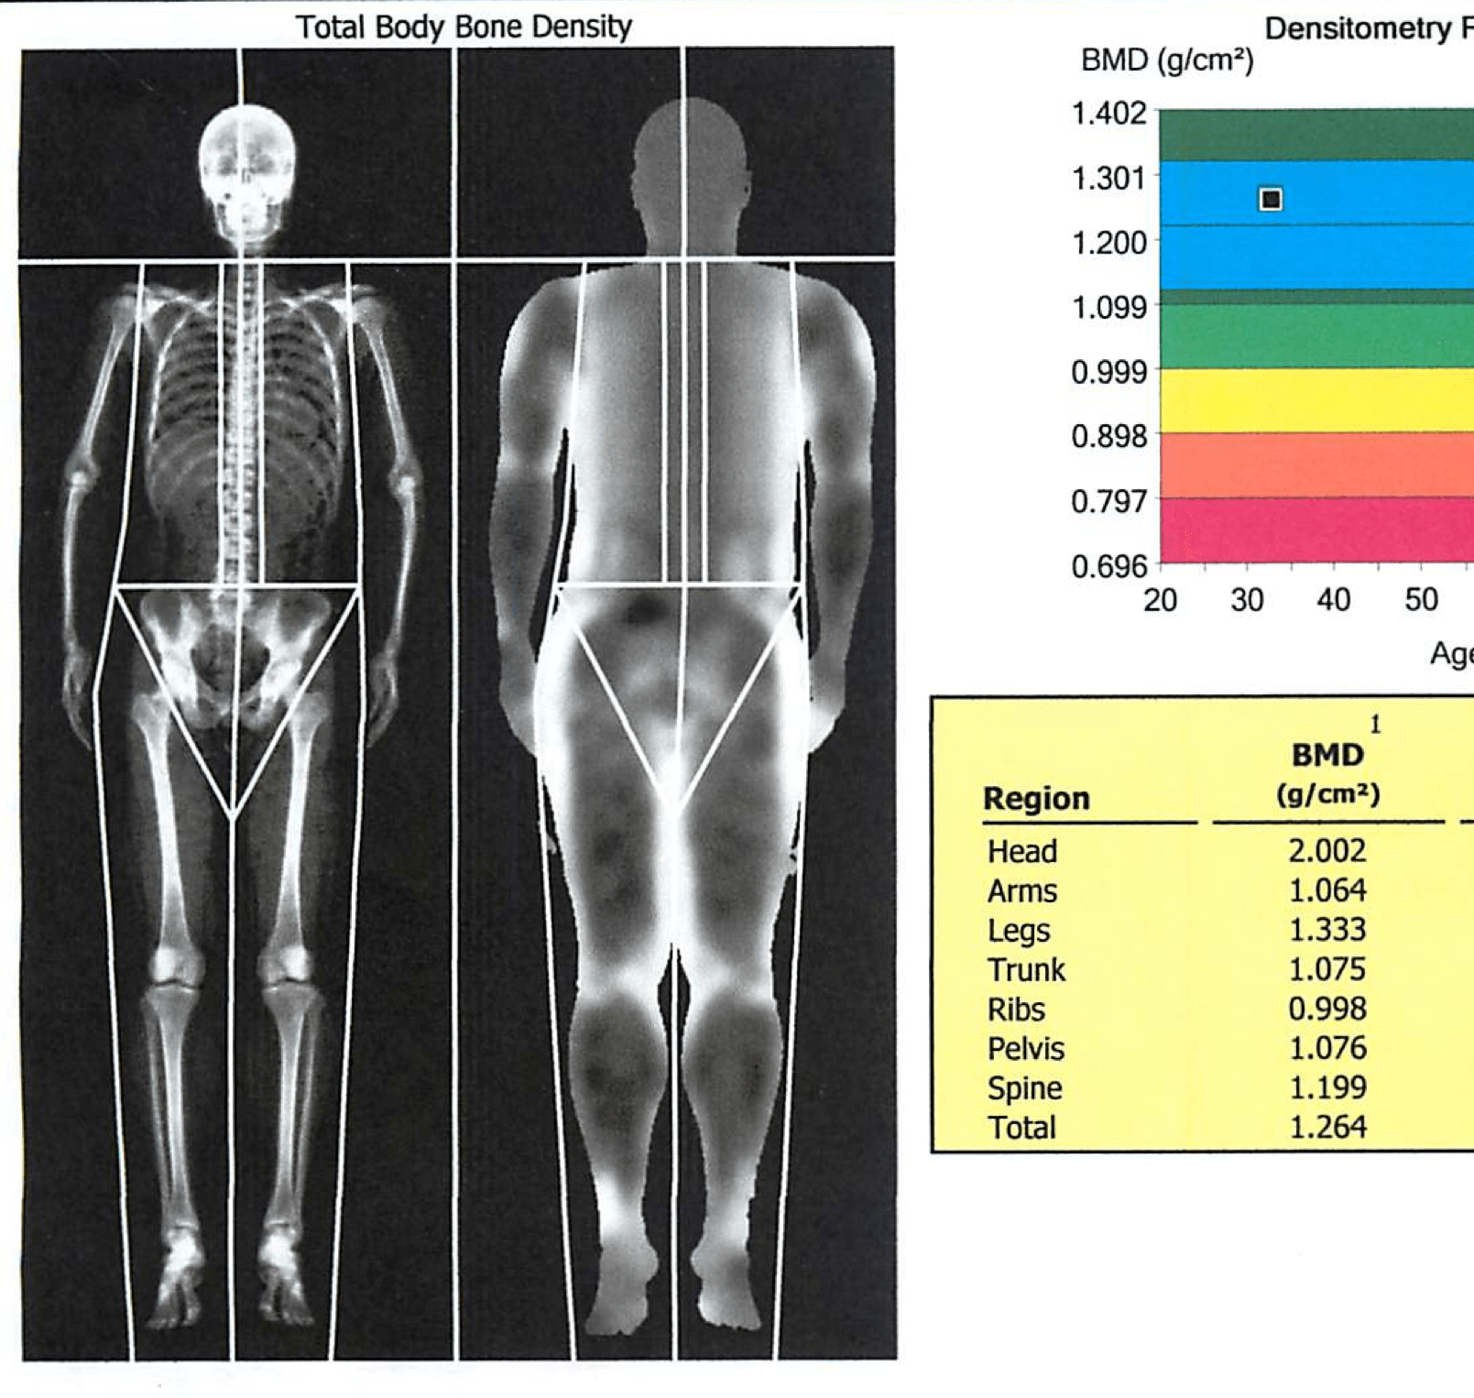
BONE DENSITY
“Scales are misleading as body weight is comprised of muscle, fat and bone all added together. DEXA determines bone mineral density (BMD) and exact body composition values.”
T Score of -2.5 indicates osteoporosis
T Score o -1.0 to -2.5 indicates osteopenia (below normal bone density)
MOST ACCURATE FORM OF DIAGNOSIS OF BONE HEALTH AND BODY COMPOSITION

Slide 6
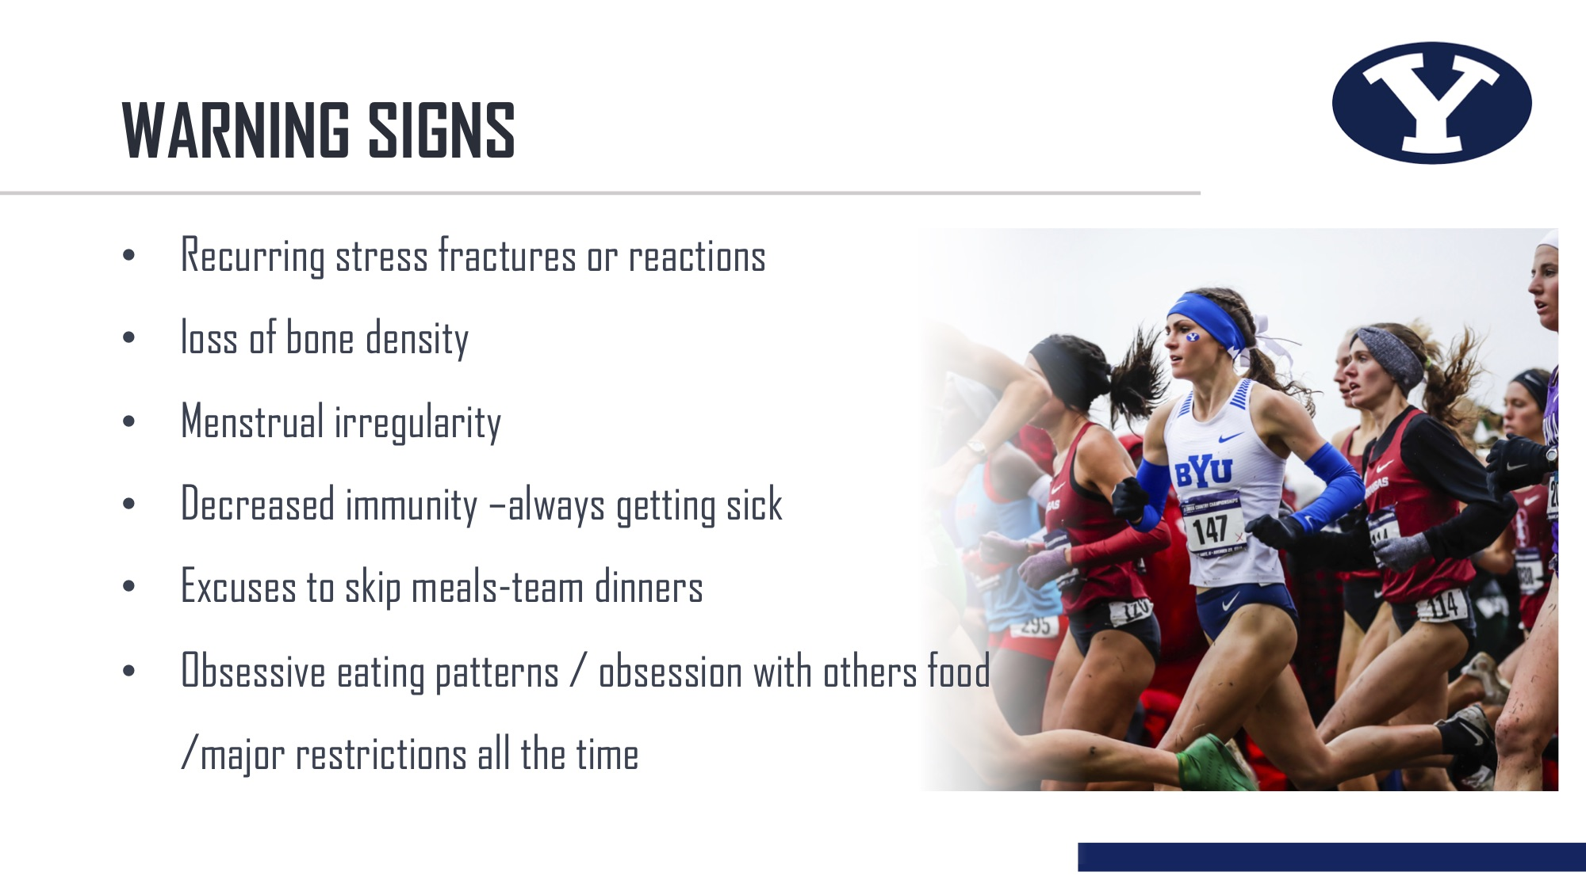
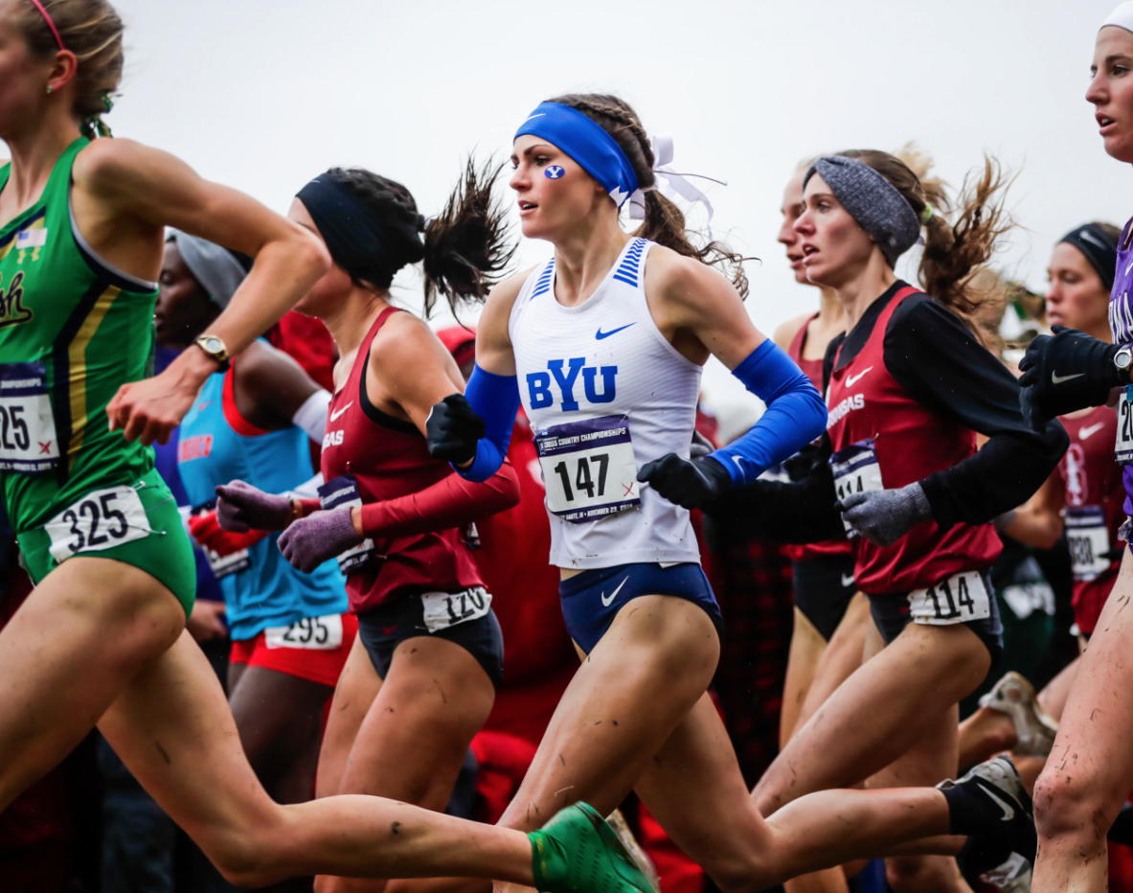
WARNING SIGNS
Recurring stress fractures or reactions
loss of bone density
Menstrual irregularity
Decreased immunity –always getting sick
Excuses to skip meals-team dinners
Obsessive eating patterns / obsession with others food /major restrictions all the time

Slide 7
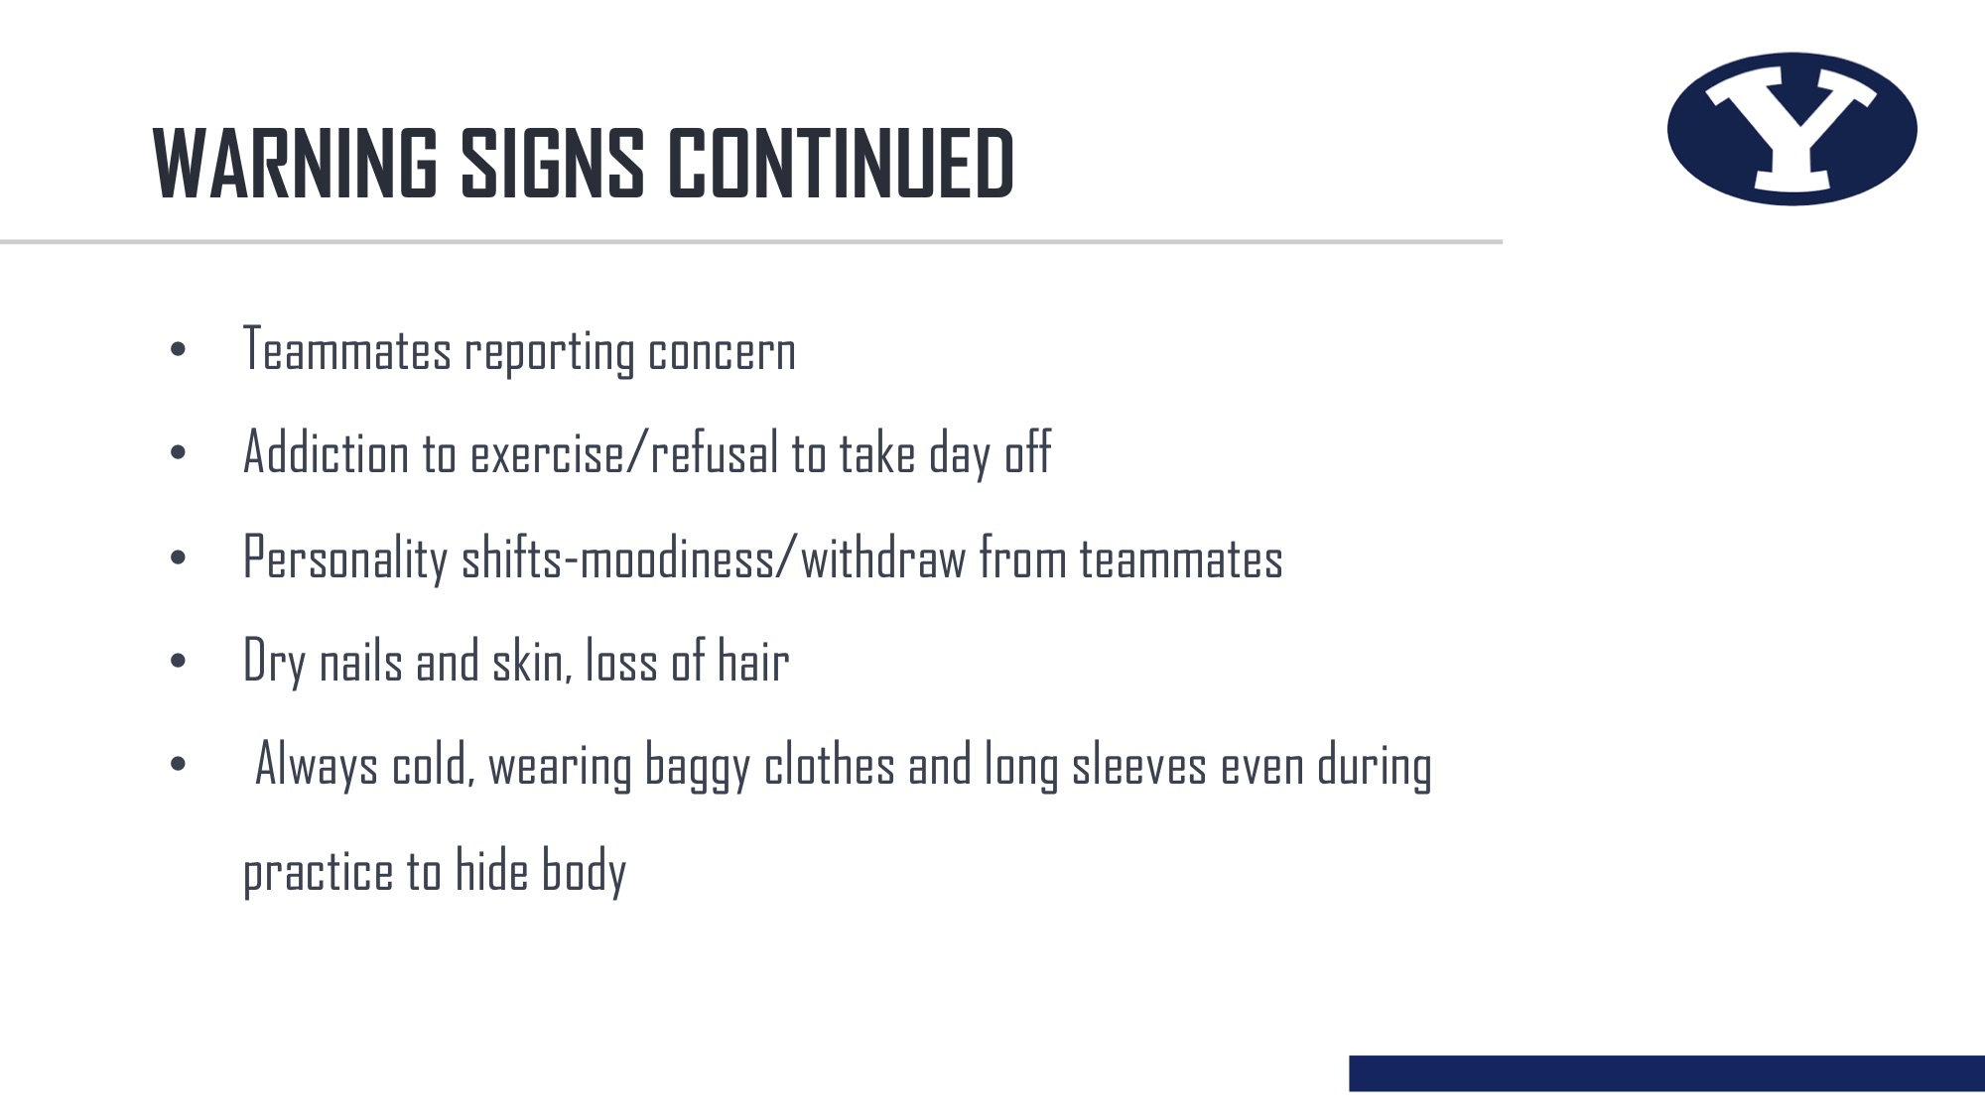
WARNING SIGNS CONTINUED
Teammates reporting concern
Addiction to exercise/refusal to take day off
Personality shifts-moodiness/withdraw from teammates
Dry nails and skin, loss of hair
Always cold, wearing baggy clothes and long sleeves even during practice to hide body

Slide 8

UNDERSTANDING YOUR WOMEN
High achievers-pressure for perfection
Mental health
issues
Fear of Failure
Train harder mentality
Type “A” Personalities

Slide 9
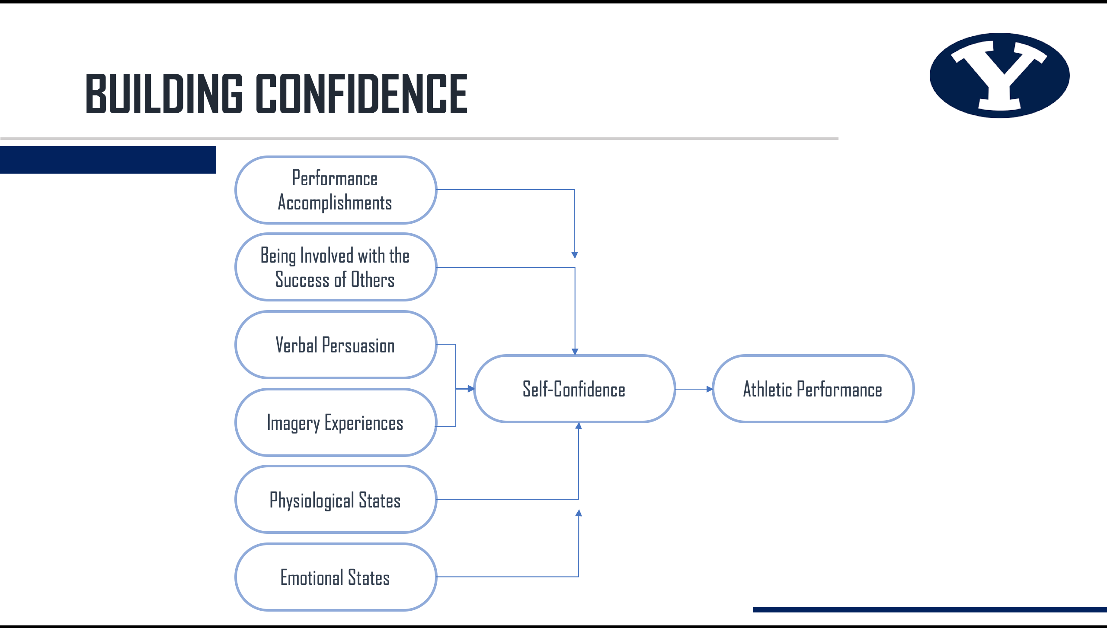
BUILDING CONFIDENCE
Performance Accomplishments
Being Involved with the Success of Others
Verbal Persuasion
Self-Confidence
Athletic Performance
Imagery Experiences
Physiological States
Emotional States

Slide 10
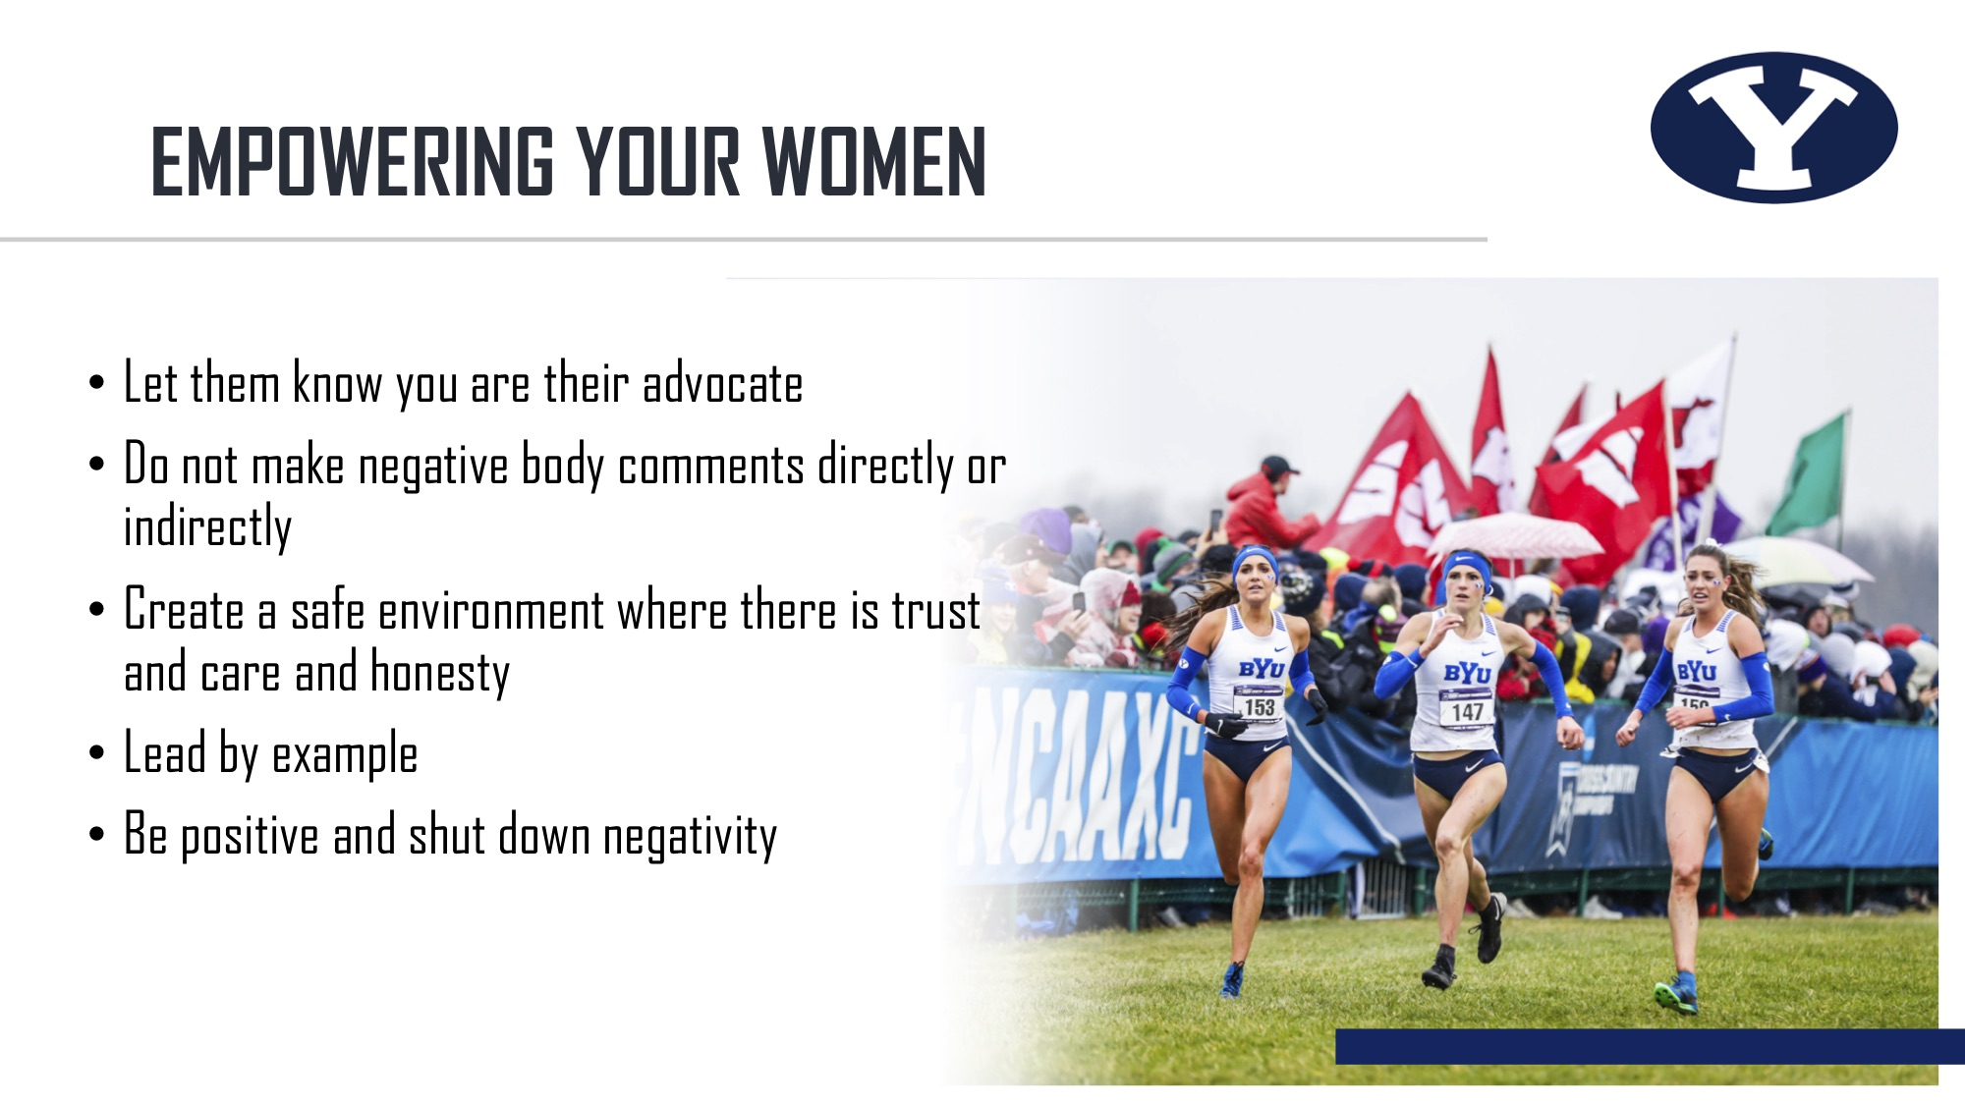
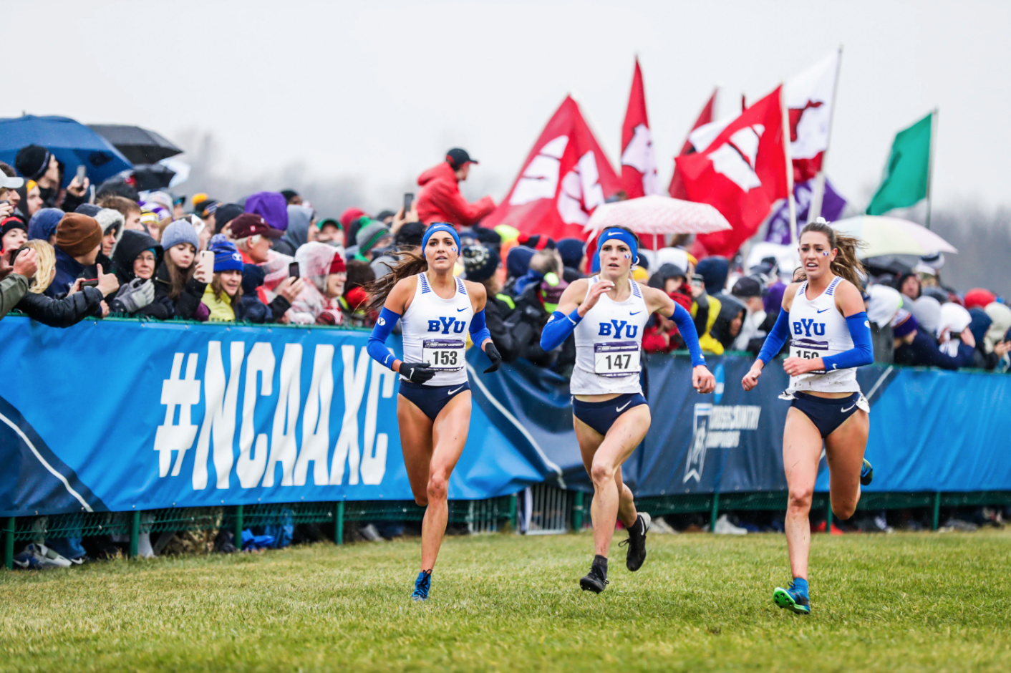
EMPOWERING YOUR WOMEN
Let them know you are their advocate
Do not make negative body comments directly or indirectly
Create a safe environment where there is trust and care and honesty
Lead by example
Be positive and shut down negativity

Slide 11

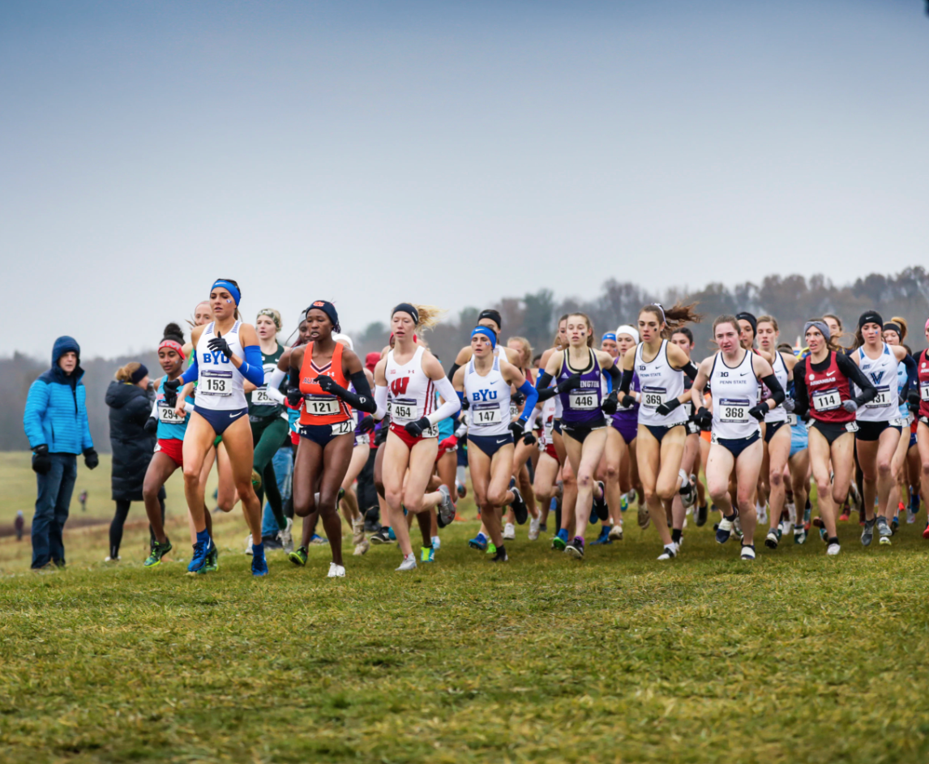
EMPOWERING YOUR WOMEN CONTINUED
Teach them that comparison is thief of joy
Be happy for other women’s success
Their worth is not dependent solely on their success in the sport
Create an atmosphere of gratitude
Believe in them

Slide 12
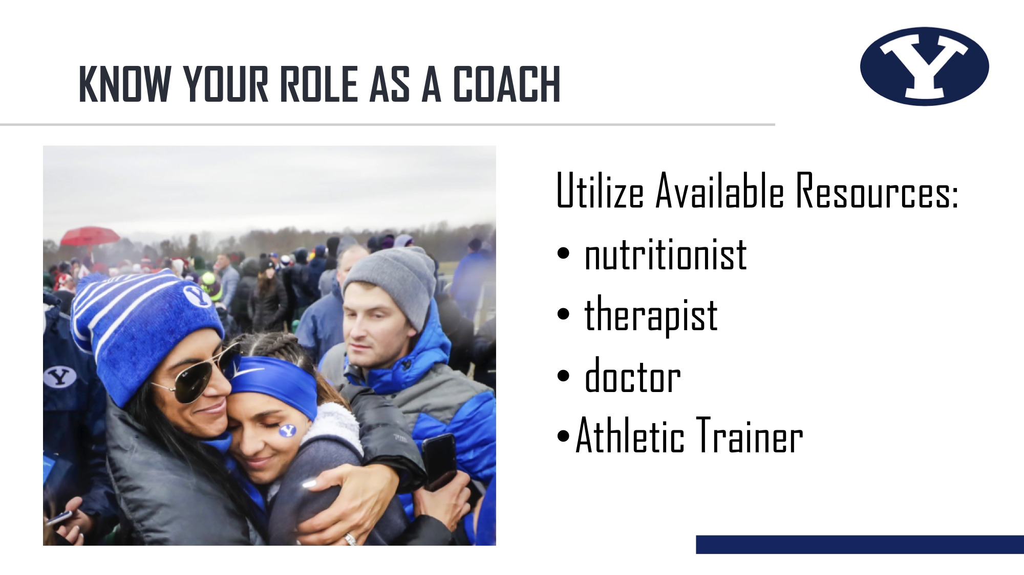
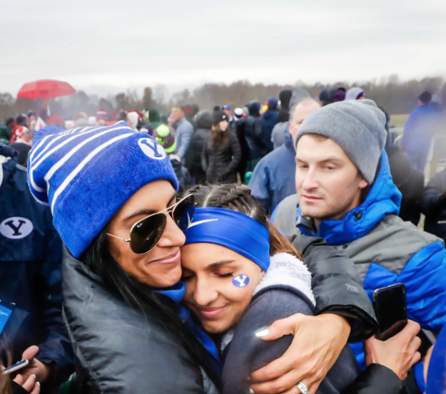
KNOW YOUR ROLE AS A COACH
Utilize Available Resources:
nutritionist
therapist
doctor
Athletic Trainer

